Slide 1

Strategic plan 2016-2018

Slide 2

Incorporation
In 2009, 32 organizations decide to establish the association, with the primary mission of fostering the environmental, social and corporative governance criteria in the investment policies in Spain, by means of the dialogue with the different social groups and contributing to the sustainable development. Currently 58 associates.

Slide 3
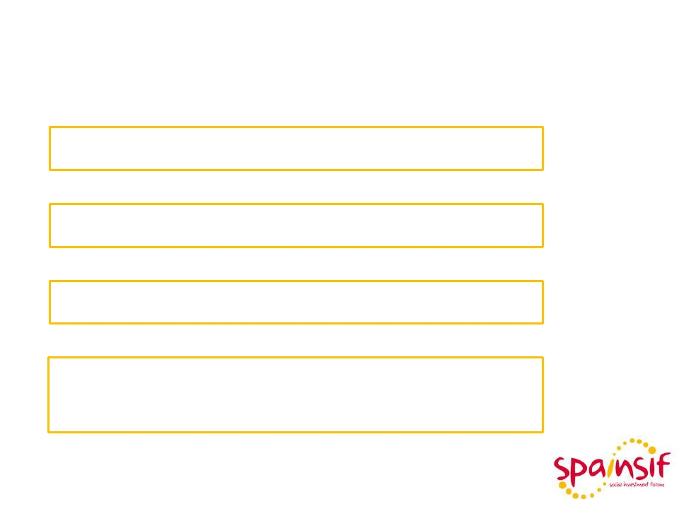
¿Why Spainsif?
Meeting platform
Reference
Generate and disseminate knowledge
Raise awareness and promote changes in investment policies

Slide 4

Statutory mission
The association’s primary mission is to foster the integration of environmental, social, and corporative governance criteria in the investment policies in Spain by means of the dialogue with the different social groups and contributing to the sustainable development.
The association aims to be a meeting and reference platform to generate and disseminate knowledge on Socially Responsible Investing (SRI from now on), as well as to raise awareness and drive changes in the investment processes in the investment community, the Public Administration, the companies and the citizenship in general.
For that purpose the Association is inspired by responsibility, transparency, sustainability, commitment, trust, plurality and independency values.

Slide 5
Associates list (56)
GROUP 1: Financial Institutions (11).
▪
BBVA, BANCO POPULAR, BANKIA, TRIODOS BANK, CECA, ATLANTIS COMPAÑIA
ASEGURADORA, CAIXA DE CREDIT DELS ENGINYERS, PETERCAM ESP, BANCO DE
CREDITO COOPERATIVO (GRUPO CAJAMAR), INSTITUTO DE CREDITO OFICIAL
(ICO), SEGUROS RGA.
GROUP 2: Asset Managers (18).
▪
CASER, FONDITEL, SANTANDER A.M., PICTET, IBERCAJA, GROPAMA A.M
AMUNDI IBERIA, ROBECO, NATIXIS G.A.M., GENERALI IE, LAZARD F.G, TRESSIS,
AMBAR CAPITAL (VIVERGI), NORDEA PENSIONES, EDMOND DE ROTHSCHILD,
BNP PARIBAS I.P., ETICA PATRIMONIOS EAFI, ROBUST G.I.
GROUP 3: SRI Service Providers and related Academic Centers (12)
▪
VIGEO, NOVASTER, SUSTAINALYTICS, CPPS, INSTITUTO DE EMPRESA B.S. , UNED,
DEUSTO B.S., M.S.C.I., VDOS, GAWA CAPITAL, FEF, MORNINGSTAR.
GROUP 4: Nonprofit Organizations (15).
ESF, ECODES, FETS, AECA, FORETICA, CREAS, AERI, CDP, FUNDACIÓN ISIS,
▪
FUNDACIÓN AFI, U. JAUME I., FUNDACIÓN ONCE,
OCOPEN, ASGECO, FUNDACIÓN MÁS FAMILIA.
GROUP 5: Trade Unions (2). CCOO, UGT .

Slide 6

Structure
All associates
President, Secretary,
5 Vice-presidents and
10 Vocals
President,
Secretary,
5 Vice-presidents
General
meeting
Management
board
Executive board
• Education and
Studies Commission
• Promotion and Communication
Commission
• Admissions Committee

Slide 7
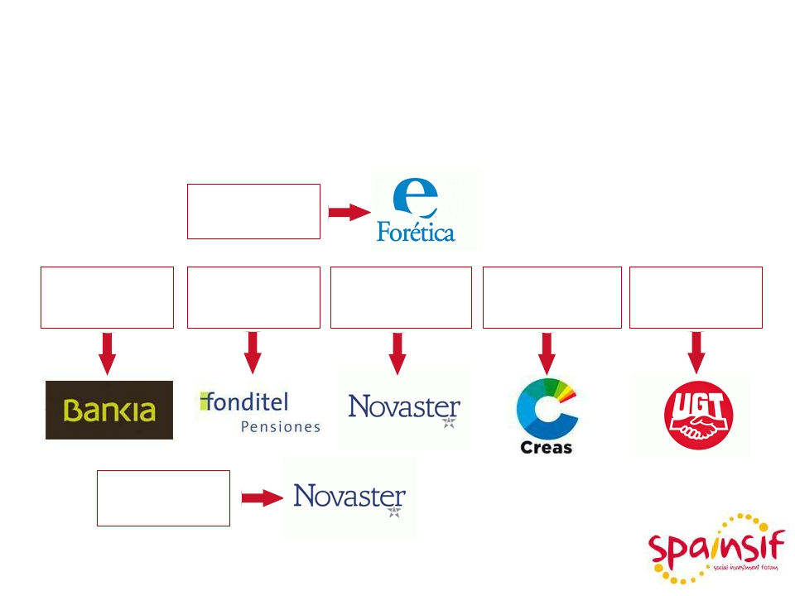







Structure
Executive Board
Presidency
Financial
institutions
Asset
Managers
Providers
And Academy
Nonprofit
organizations
Trade unions
Treasurer

Slide 8
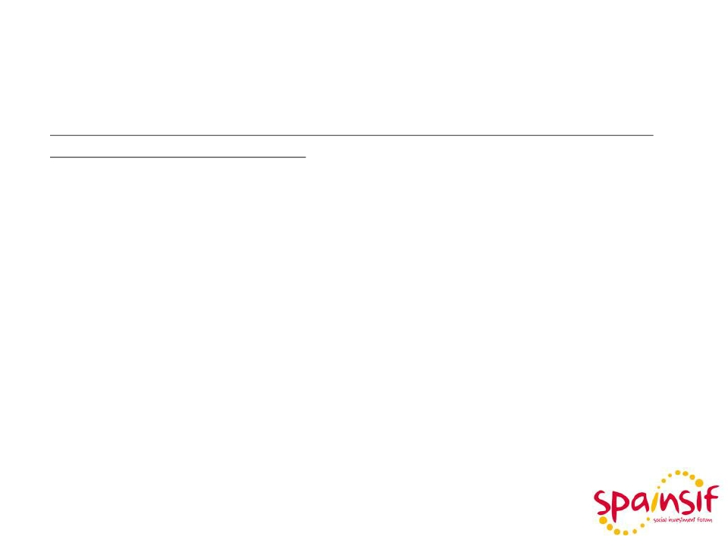
Strategic Lines
In order to achieve its objectives, the association will have the following strategic action lines:
1. The SRI promotion to generate demand and supply in Spain for which the following activities will be carried out :
a) SRI diffusion through educative and/or information campaigns on SRI. Development of publications and other services.
b) SRI research promotion in collaboration with Universities, Business Schools and Institutions.
c) Collaboration with stakeholders fostering the cooperation with the international SIF network and other organizations interested in adopting responsible investment practices .

Slide 9

Strategic Lines
Strategic Plan Lines 2016-2018
• Annual event
• SRI week
Promotion
Institutional
relevance
Research and
y education
• Business breakfasts
• SRI Observatory
• Communication plan
• Network and web relevance
• Retail market
• Relationship with the administration
• Relationship with regulatory bodies
• Relationship with the media
• Relationships with other stakeholders
• Own research
• Eurosif research
• Collaboration with universities
• Specific action to boost education
and research

Slide 10
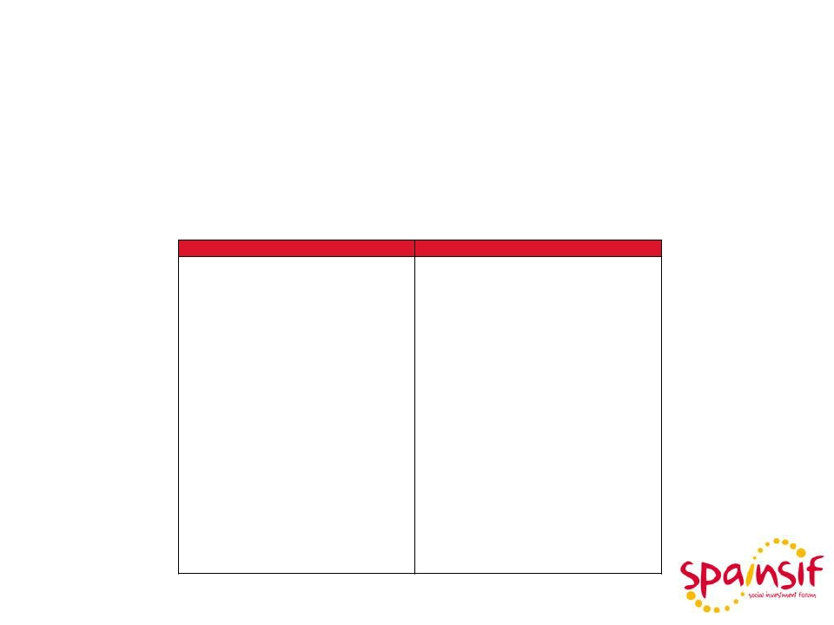
Strategic Lines
Specific lines of action: Strategic Plan 2016-2018
SRI Retail Promotion
Actions from the Supply | Actions from the Demand
•Meetings with regulatory bodies and supervisors. •Fair with exhibitors and conferences. •Internal diffusion and formation. •Commitment to promote the associates’ SRI offer. •SRI visibility in the media, communication reinforcement. | •Initiatives with representative associations of the demand. •Joint acts with other organizations whose target is the investor or the individual saver. •SRI visibility in the media, communication reinforcement. •Socially Responsible financial education. •Specific media campaigns with the Consumer Associations.

Slide 11
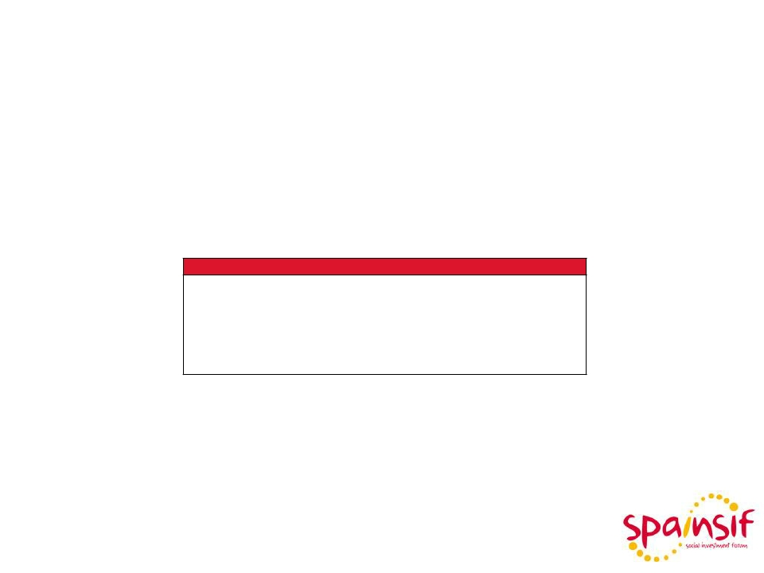
Strategic Lines
Specific lines of action: Strategic Plan 2016-2018
Research and
Education Boost
Actuations
▪
▪
▪
▪
▪
▪
Agreements with Universities and Business Schools.
Cross training for professionals.
Research initiatives in teaching centers.
Financial Education Plan Development.
SRI Education Practices.
SRI Module for Universities and Business Schools.
The
Education and research are
fundamental activities for the
development of SRI, given that it
affects the supply and the demand.

Slide 12
International Presence
• Member of Eurosif’s Board.
• Participation in Eurosif’s studies at European level.
• Participation in Eurosif’s European normative consultation groups
on SRI.
• International Networking (Global Sustainable Investment Alliance).
• Collaboration with VBDO (Ditch SIF) in research studies.
• Collaboration with FIR (French SIF). Participation in events.
• Collaboration with UKSIF (British SIF). Participation in events.
• Collaboration with FNG (German, Austrian and Swiss SIF).
• Agreement with TBLI.
• Agreement with UN-PRI (Speakers in the annual event).

Slide 13
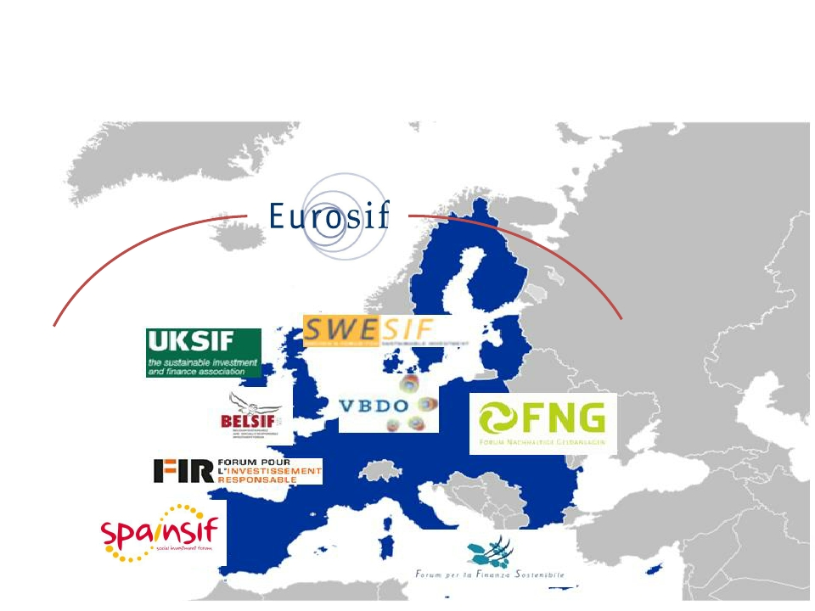
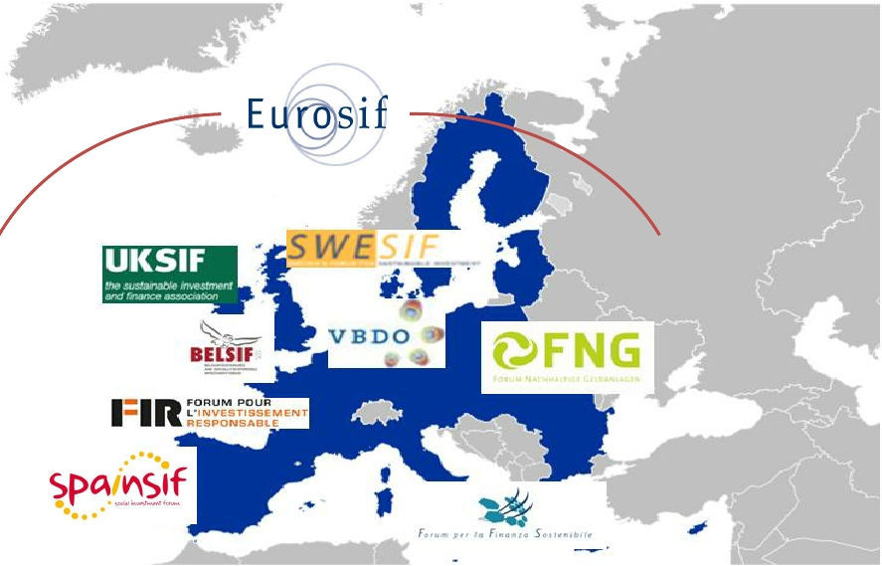


European SIF’s Association: Eurosif

Slide 14










SIFs Global Network
European SIFs:
12

Slide 15








SIFs Global Network
SIFs outside Europe:
13

Slide 16
C/ Serrano, 240, 5th floor -28016 Madrid-
www.spainsif.es Phone 91 443 08 20

